Slide 1
BINARY LOGISTICS REGRESSION

Slide 2
INTRODUCTION
Logistic regression is the appropriate regression analysis to conduct when the dependent variable is dichotomous (binary).
Logistic regression is used to describe data and to explain the relationship between one dependent binary variable and one or more nominal, ordinal, interval or ratio-level independent variables.
Example: Do body weight, calorie intake, fat intake, and age have an influence on the probability of having a heart attack (yes vs. no)?

Slide 3
ASSUMPTION
The dependent variable should be dichotomous in nature (e.g., presence vs. absent).
There should be no outliers in the data, which can be assessed by converting the continuous predictors to standardized scores, and removing values below -3.29 or greater than 3.29.
There should be no high correlations (multicollinearity) among the predictors. This can be assessed by a correlation matrix among the predictors. Tabachnick and Fidell (2013) suggest that as long correlation coefficients among independent variables are less than 0.90 the assumption is met.

Slide 4

MODEL EVALUATION
The logistic regression analysis is the task estimating the log odds of an event. Mathematically, logistic regression estimates a multiple linear regression function defined as:
Logit (p)
Overfitting. When selecting the model for the logistic regression analysis, another important consideration is the model fit. Adding independent variables to a logistic regression model will always increase the amount of variance explained in the log odds (typically expressed as R²). However, adding more and more variables to the model can result in overfitting, which reduces the generalizability of the model beyond the data on which the model is fit.
Reporting the R². Numerous pseudo-R² values have been developed for binary logistic regression. These should be interpreted with extreme caution as they have many computational issues which cause them to be artificially high or low. A better approach is to present any of the goodness of fit tests available; Hosmer-Lemeshow is a commonly used measure of goodness of fit based on the Chi-square test.

Slide 5
EXAMPLE
Example using R: https://stats.oarc.ucla.edu/r/dae/logit-regression/
Example using SPSS
In this example, there are six variables: (1) heart_disease, which is whether the participant has heart disease: "yes" or "no" (i.e., the dependent variable); (2) VO2max, which is the maximal aerobic capacity; (3) age, which is the participant's age; (4) weight, which is the participant's weight (technically, it is their 'mass'); and (5) gender, which is the participant's gender (i.e., the independent variables); and (6) caseno, which is the case number.

Slide 6
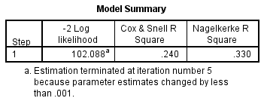
INTERPRETING THE OUTPUT
Variance explained
In order to understand how much variation in the dependent variable can be explained by the model (the equivalent of R² in multiple regression), you can consult the table below, "Model Summary“.
This table contains the Cox & Snell R Square and Nagelkerke R Square values, which are both methods of calculating the explained variation. These values are sometimes referred to as pseudo R² values (and will have lower values than in multiple regression). However, they are interpreted in the same manner, but with more caution. Therefore, the explained variation in the dependent variable based on our model ranges from 24.0% to 33.0%, depending on whether you reference the Cox & Snell R² or Nagelkerke R² methods, respectively.

Slide 7
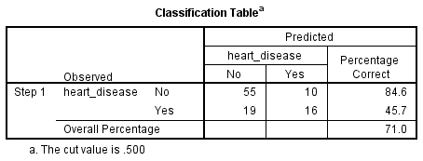
Category prediction
Binomial logistic regression estimates the probability of an event (in this case, having heart disease) occurring. If the estimated probability of the event occurring is greater than or equal to 0.5 (better than even chance), SPSS Statistics classifies the event as occurring (e.g., heart disease being present). If the probability is less than 0.5, SPSS Statistics classifies the event as not occurring (e.g., no heart disease).
The binomial logistic regression to predict whether cases can be correctly classified (i.e., predicted) from the independent variables.
So, it becomes necessary to have a method to assess the effectiveness of the predicted classification against the actual classification

Slide 8
Firstly, notice that the table has a subscript which states, "The cut value is .500". This means that if the probability of a case being classified into the "yes" category is greater than .500, then that particular case is classified into the "yes" category. Otherwise, the case is classified as in the "no" category (as mentioned previously).
The model is fit as the overall classification is above 70%.

Slide 9
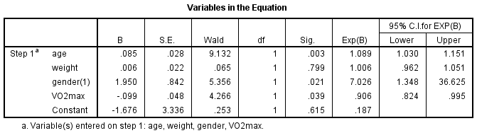
Variables in the equation
The Wald test ("Wald" column) is used to determine statistical significance for each of the independent variables. The statistical significance of the test is found in the "Sig." column. From these results you can see that age (p = .003), gender (p = .021) and VO2max (p = .039) added significantly to the model/prediction, but weight (p = .799) did not add significantly to the model. You can use the information in the "Variables in the Equation" table to predict the probability of an event occurring based on a one unit change in an independent variable when all other independent variables are kept constant. For example, the table shows that the odds of having heart disease ("yes" category) is 7.026 times greater for males as opposed to females.

Slide 10
Conclusion
A logistic regression was performed to ascertain the effects of age, weight, gender and VO₂max on the likelihood that participants have heart disease. The logistic regression model was statistically significant, χ²(4) = 27.402, p < .0005. The model explained 33.0% (Nagelkerke R²) of the variance in heart disease and correctly classified 71.0% of cases. Males were 7.02 times more likely to exhibit heart disease than females. Increasing age was associated with an increased likelihood of exhibiting heart disease, but increasing VO₂max was associated with a reduction in the likelihood of exhibiting heart disease.

Slide 11
THANK YOU!

